Slide 1
PART II: requirements document
Software Requirements Specification (SRS)

Slide 2
Objective
To understand how requirements may be organized in a software requirements document
To adopt a standard in producing a requirements document
To focus on specific requirements that include the analysis models

Slide 3
Software Requirements Document
Software requirements document is an official statement of what is required for the reference of software developers
Should include both definitions of user requirements and specifications of the system requirements
It is NOT a design document
As far as possible, it should set WHAT the system should do rather than HOW it should do it

Slide 4
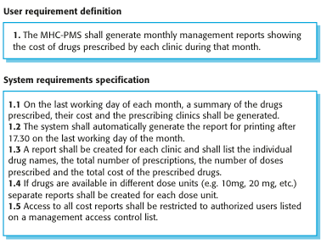
User and System Requirements
Recall

Slide 5
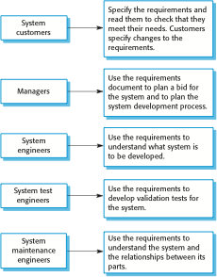
Users of a Requirements Document

Slide 6
Requirements Document Variability
Information in requirements document depends on type of system and the approach used in its development
Systems developed incrementally will, typically, have less detail in the requirements document
Requirements documents standards have been designed e.g. IEEE standard
These are mostly applicable to the requirements for large software projects

Slide 7
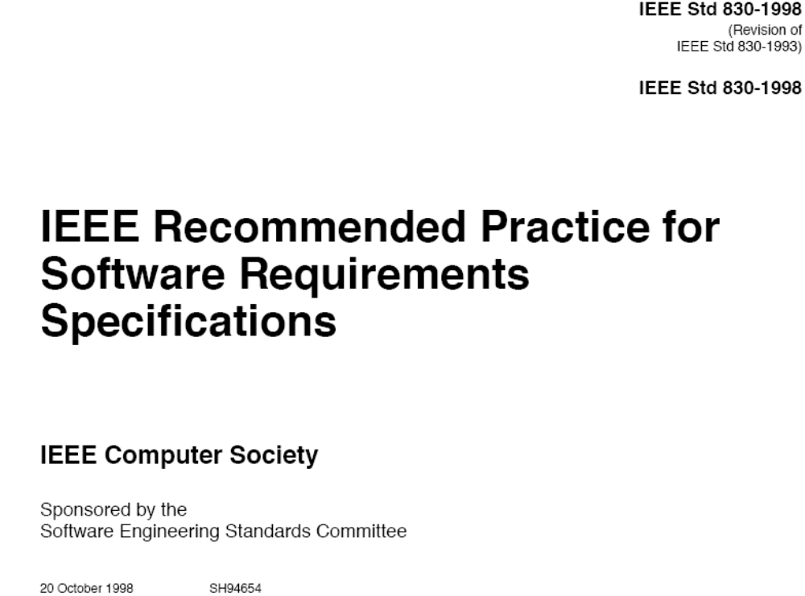
IEEE Std 830-1998

Slide 8
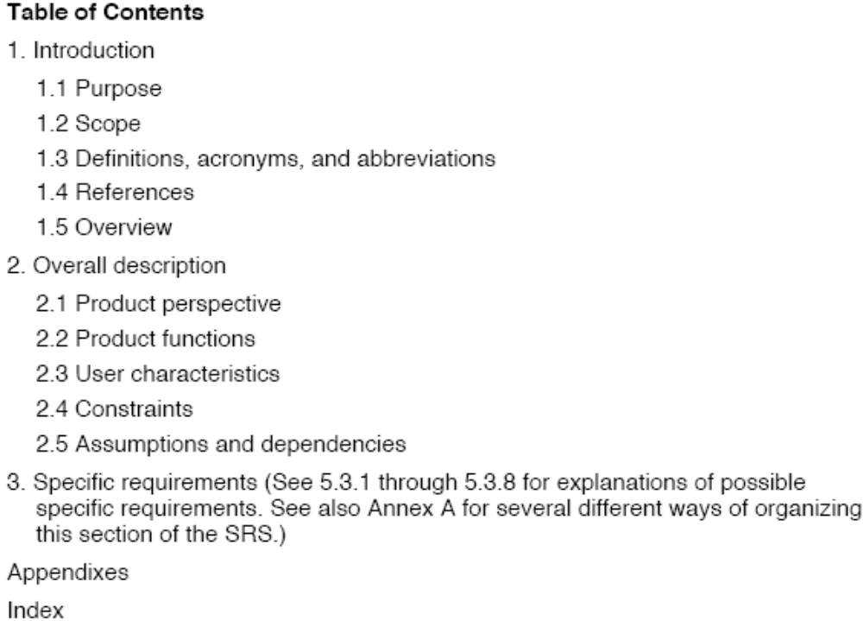
SRS Outline of IEEE Std 830-1998
See page 11 of IEEE Std 830-1998

Slide 9
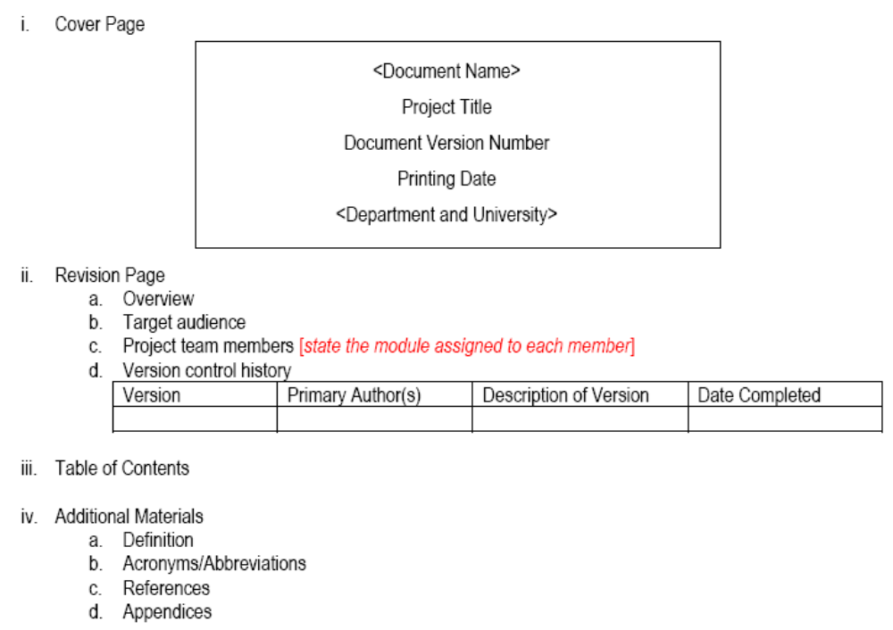
Example of Template for the Front Part of SRS Document

Slide 10
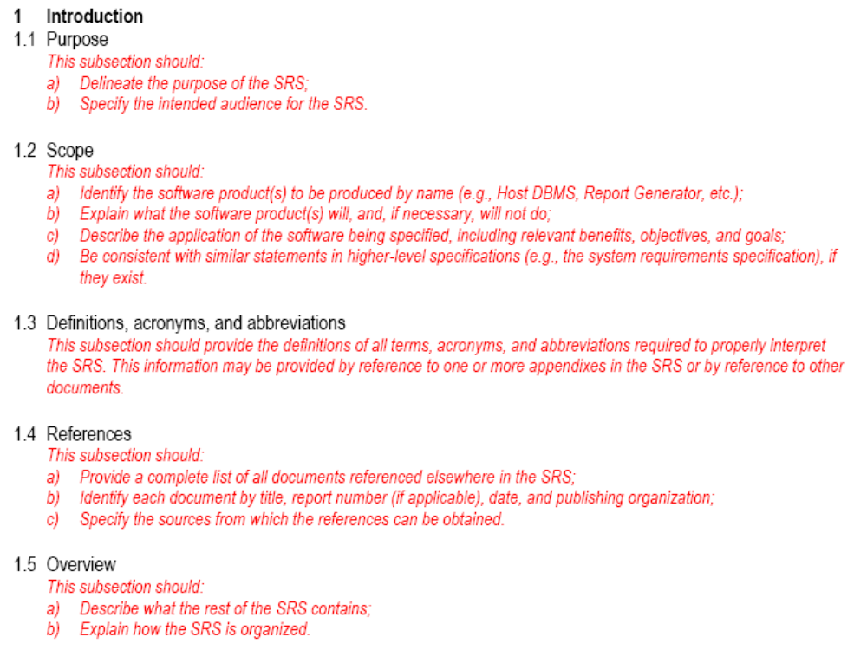
Section 1: Introduction

Slide 11
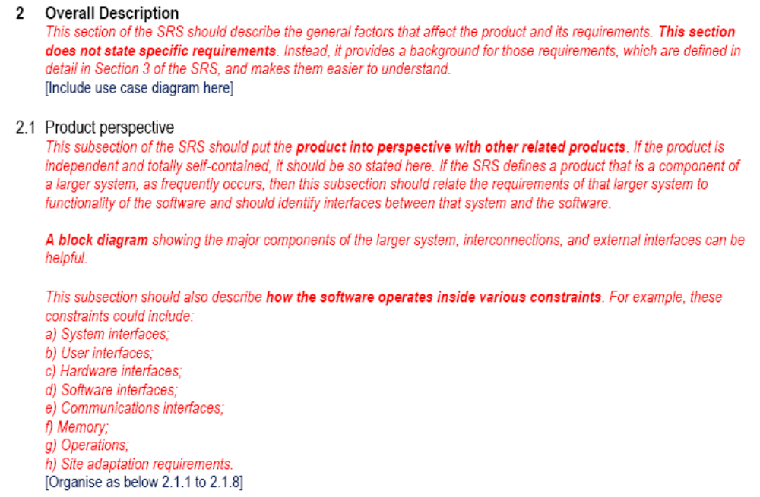
Section 2: Overall Description,
Sub-Section 2.1

Slide 12
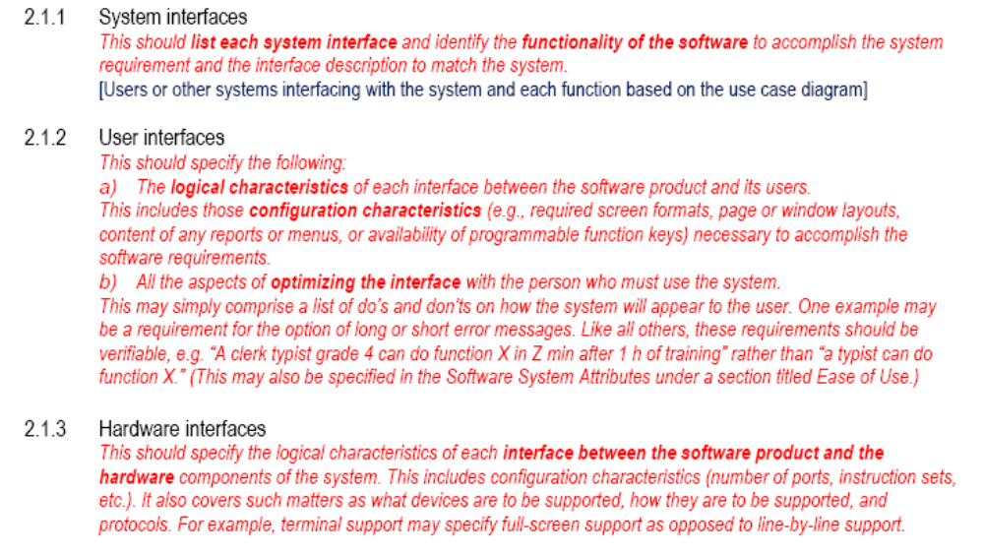
Sub-sections 2.1.1 to 2.1.3

Slide 13
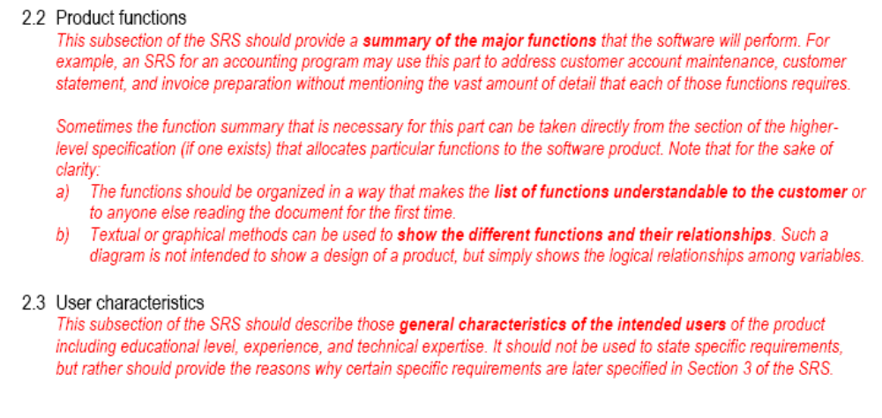
Sub-sections 2.2 & 2.3

Slide 14
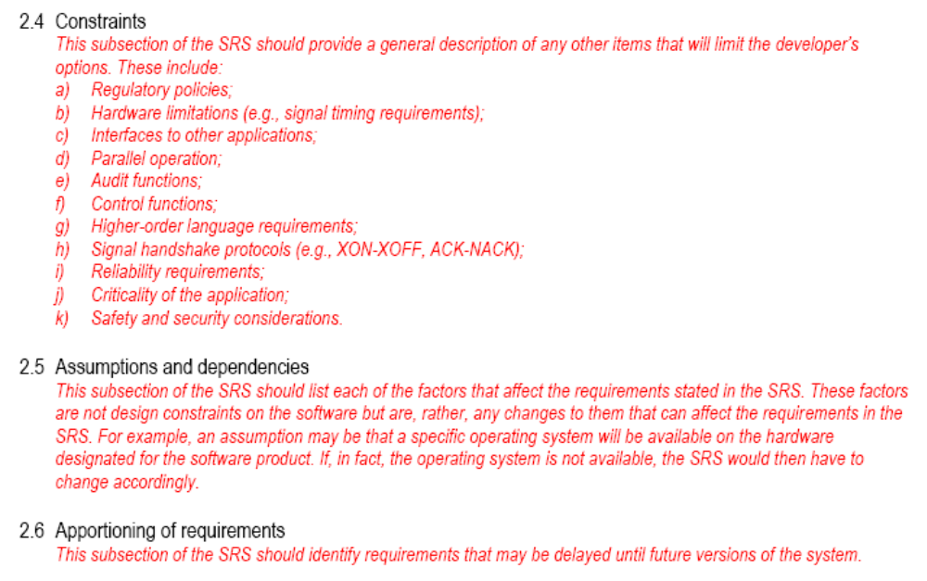
Sub-sections 2.4 to 2.6

Slide 15
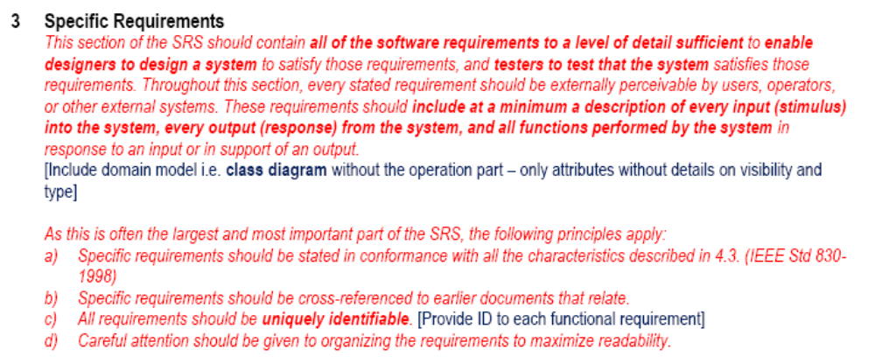
Section 3: Specific Requirements
Note: Focus on “Specific Requirements” for the scope of this course – see the given System Documentation template that combines the required details for analysis (Section 2), design (Section 3 to 6) and testing (Section 7 and 8) to meet the minimum requirements of this course

Slide 16
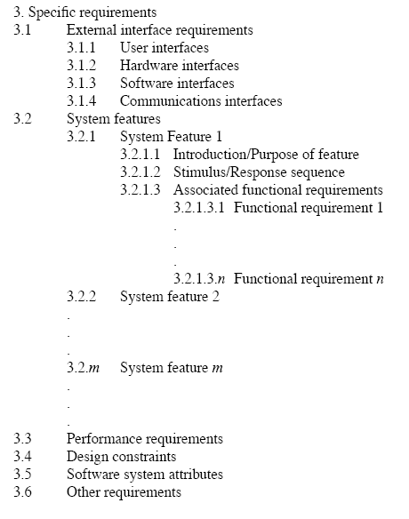
Appendix A.5 Template of SRS Section 3: Organized by Feature (IEEE Std 830-1998)
Sections 3.1.1 to 3.1.4 provide the details of what described in Sections 2.1.2 to 2.1.5
For each functional requirement, include the use case diagram and its details using use case description
Include sequence diagram and activity diagram for each use case i.e. functional requirement
Include state diagram for classes with states under respective use cases
Our Focus

Slide 17
Key Points
The software requirements document is an agreed statement of the system requirements
It should be organized so that both system customers or users and software developers can use it
Documentation standard can be referred and customized based on stakeholders’ needs

